Slide 1

AML 3406
AI and ML Capstone Project
Prepared by.:
Dev Makwana - C0885064
Krina Patel - C0886861
Mahaveersinh Chauhan - C0884854
Nikita Maru - C0883240
Trushna Patel - C0886910
Guided by.:
Dr. Vahid Hadavi
Harmony
Your Virtual Psychiatrist

Slide 2

Outline
Introduction
Datasets Details
Technologies
Approaches
Data Preprocessing
Data Exploration and Visualization
Methods Used
Model Evaluation
Result
Limitations
Application
Conclusion and Future Work
References

Slide 3
Introduction
"Harmony" is designed to provide support for coping mechanisms, stress, anxiety, and depression therapies, as well as acting as a point of contact for emergency support and mental health services.
The chatbot provides easy and immediate access to mental health support, reaching individuals who may lack resources or face barriers to traditional care.
Offering a private and non-judgmental platform, the chatbot encourages more people to seek help for mental health issues, helping to break down the stigma associated with these discussions.

Slide 4
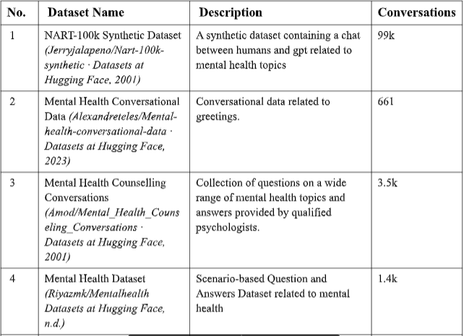
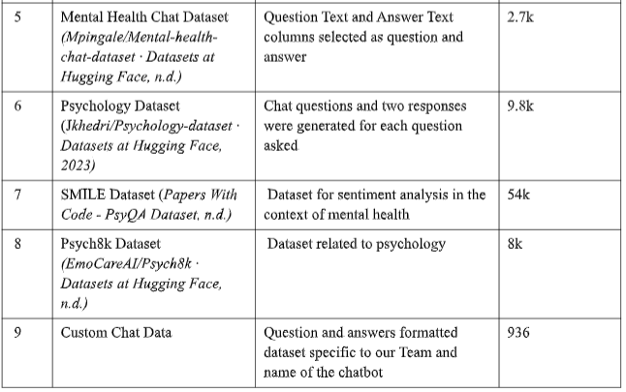
Datasets

Slide 5
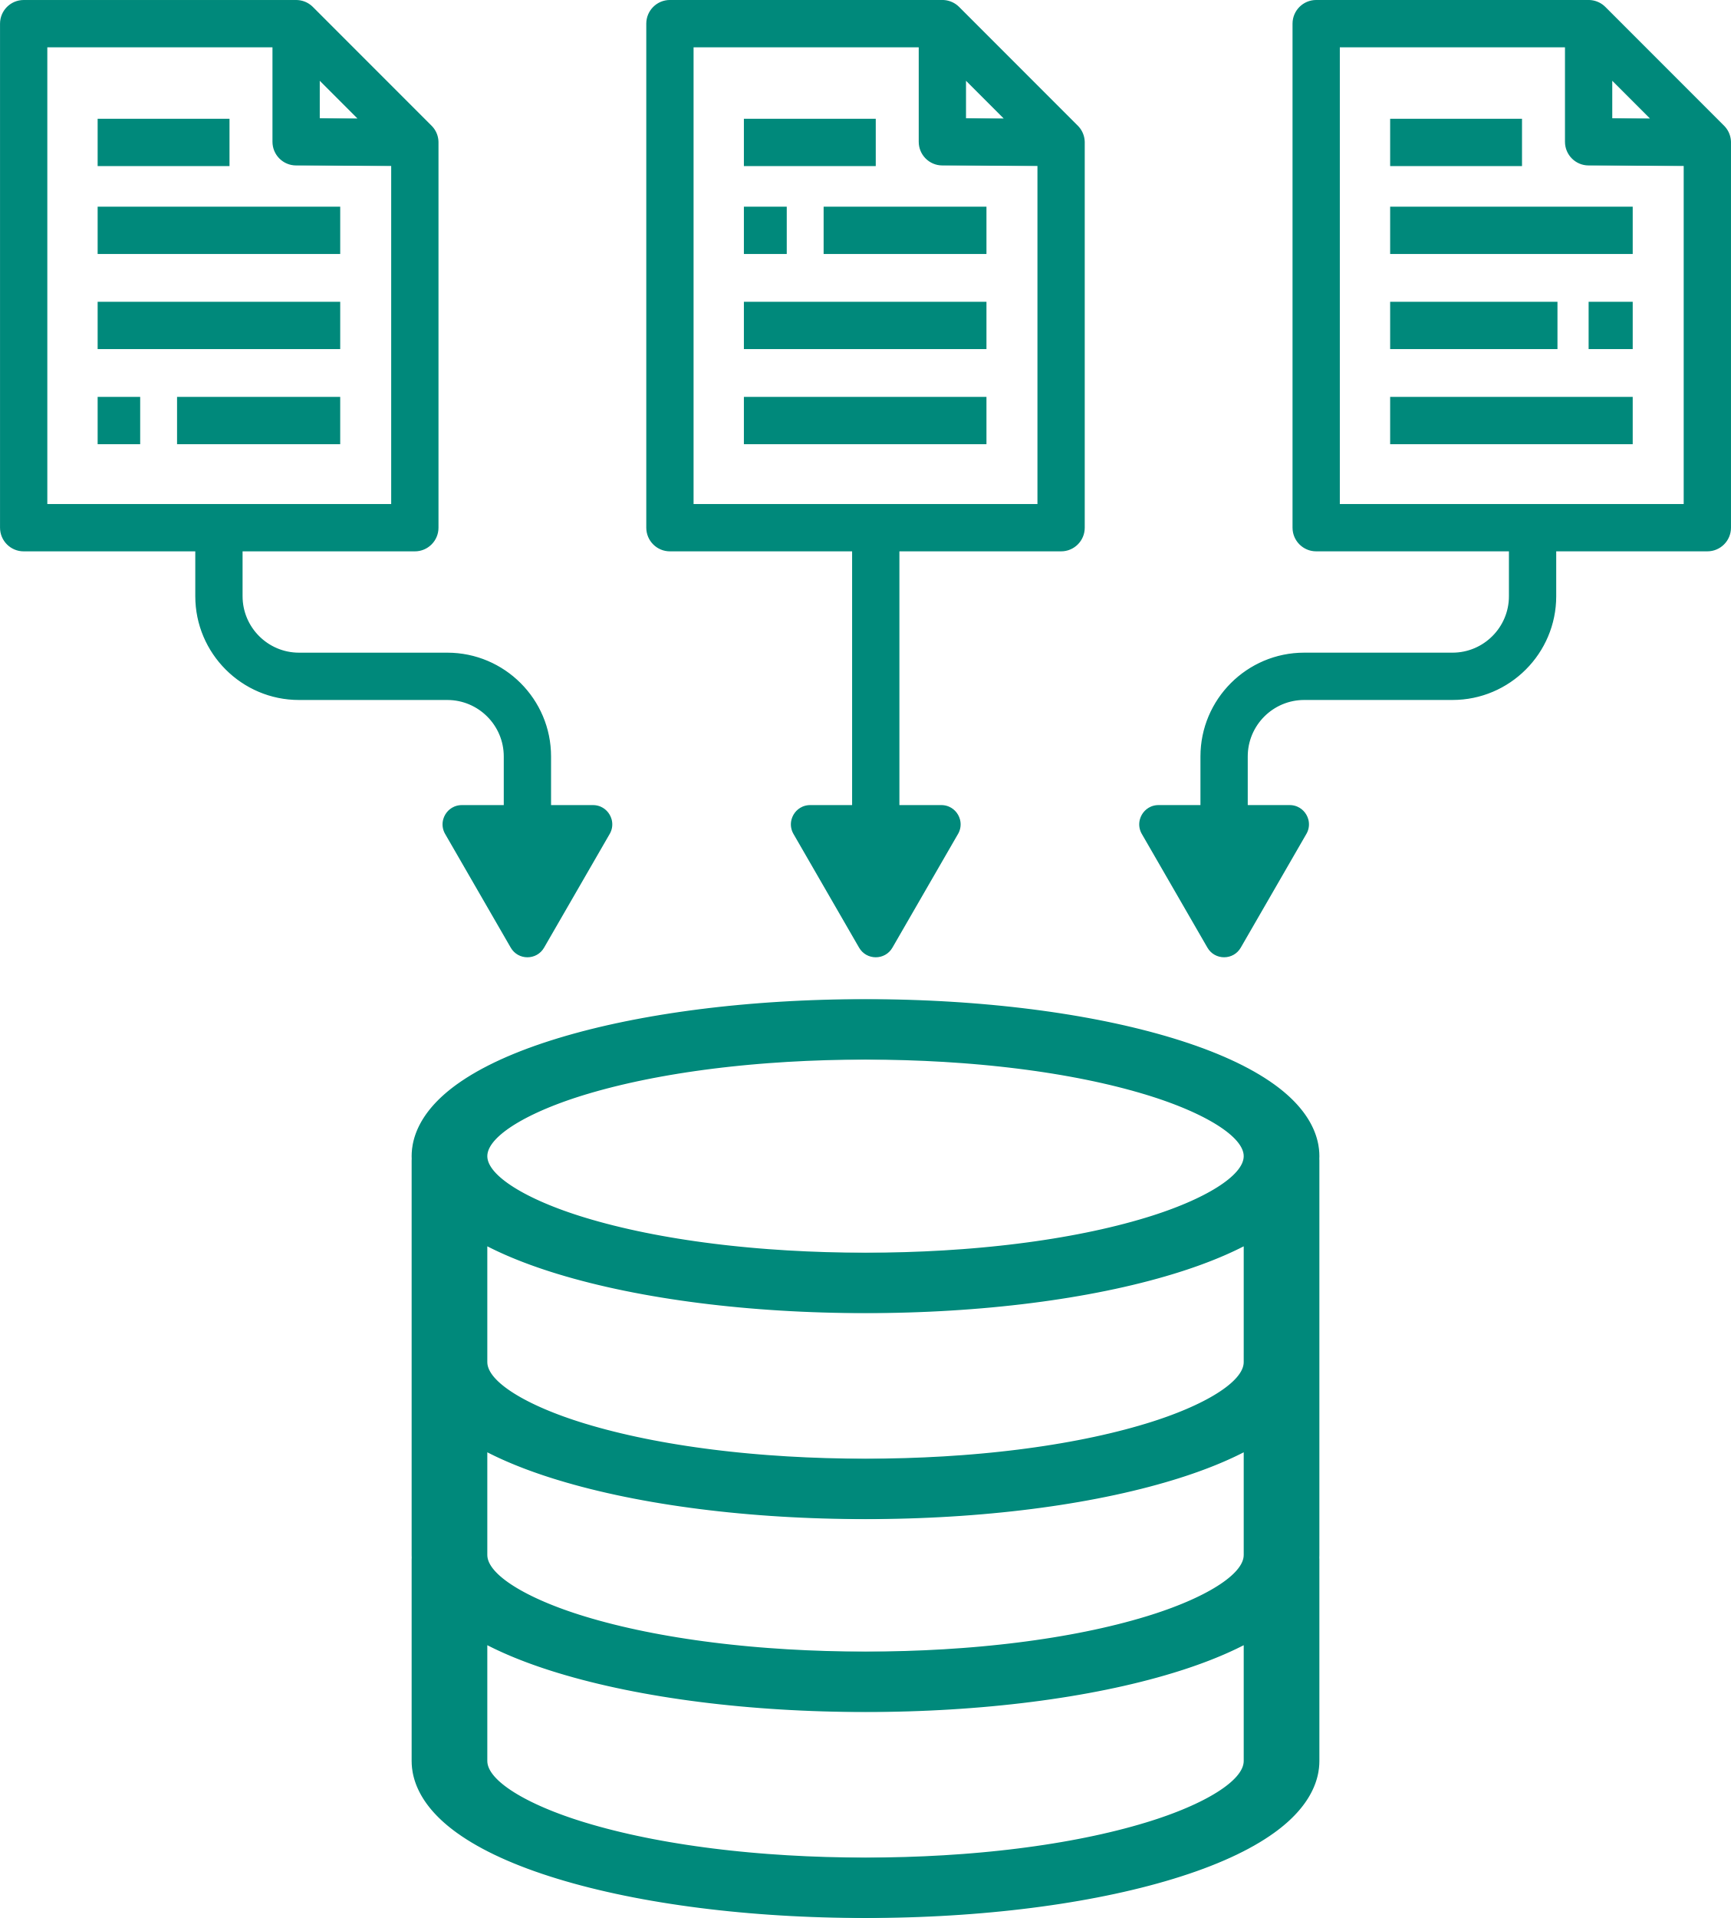
Merged Format of Dataset
human: hey there
gpt: hi there. what brings you here today?
human: i'm feeling extremely upset today. it's so hard to trust in myself.
gpt: i'm here for you. can you tell me more about what's causing you to feel upset and why it's difficult to trust yourself?
human: i constantly doubt my abilities and feel like i'm never good enough. it's hard to have confidence in my decisions when i'm afraid of making mistakes.
gpt: it sounds like self-esteem is a major issue for you. can you recall any specific experiences or moments that have contributed to this lack of trust in yourself?

Slide 6
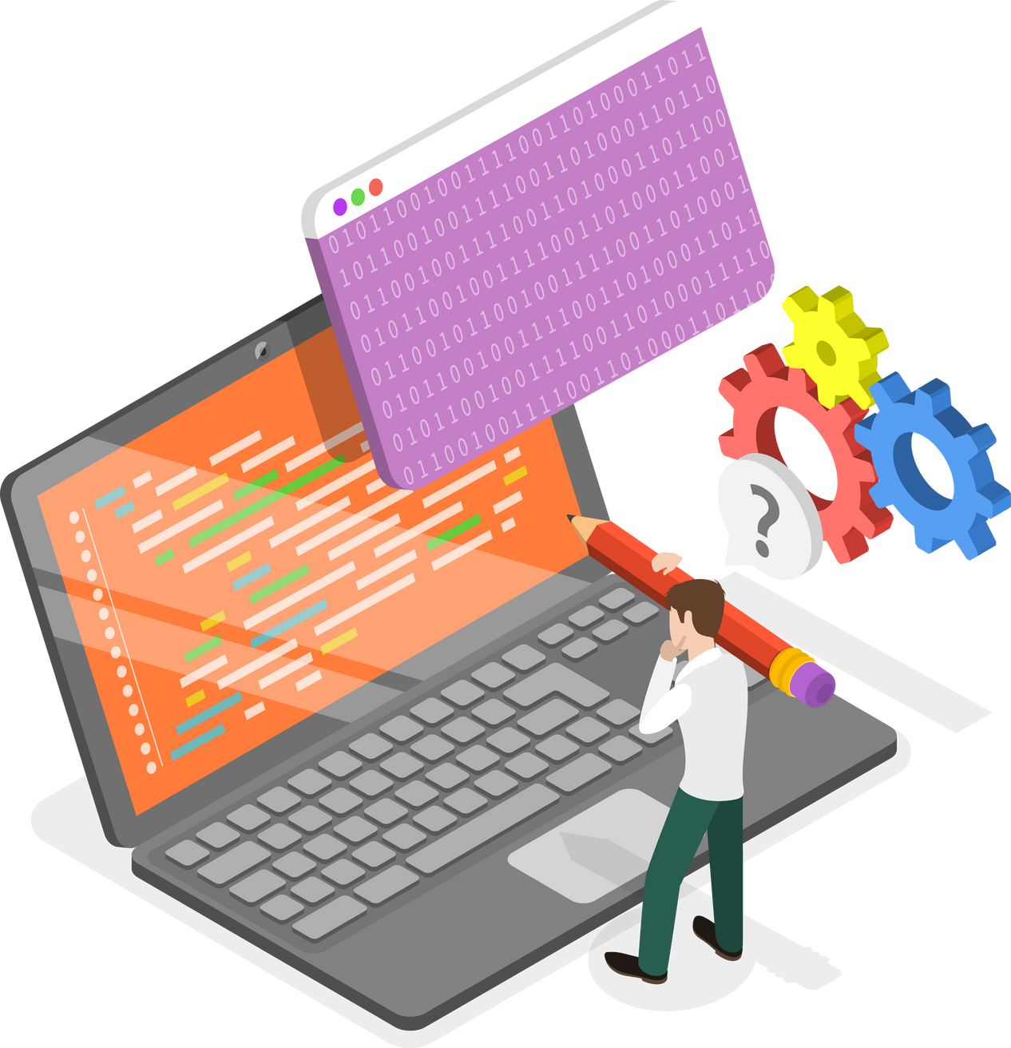
Technologies
Front End
React JS
Tailwind CSS
Particle JS
Backend
Fast API
Machine Learning
PyTorch
Transformers
Databases
MongoDB

Slide 7


Approaches
Approach - 1: Implementation of chatbot with Text Generation using books
Limitation: Unable to maintain conversation
Approach - 2: Implementation of Chatbot using Conversational data.

Slide 8

Data Preprocessing
Named entity removal
To make data anonymous
Text translation from Chinese
To have linguistic consistency
Enhance conversations
To make it more human like
Merging conversations
To have a streamlined format

Slide 9
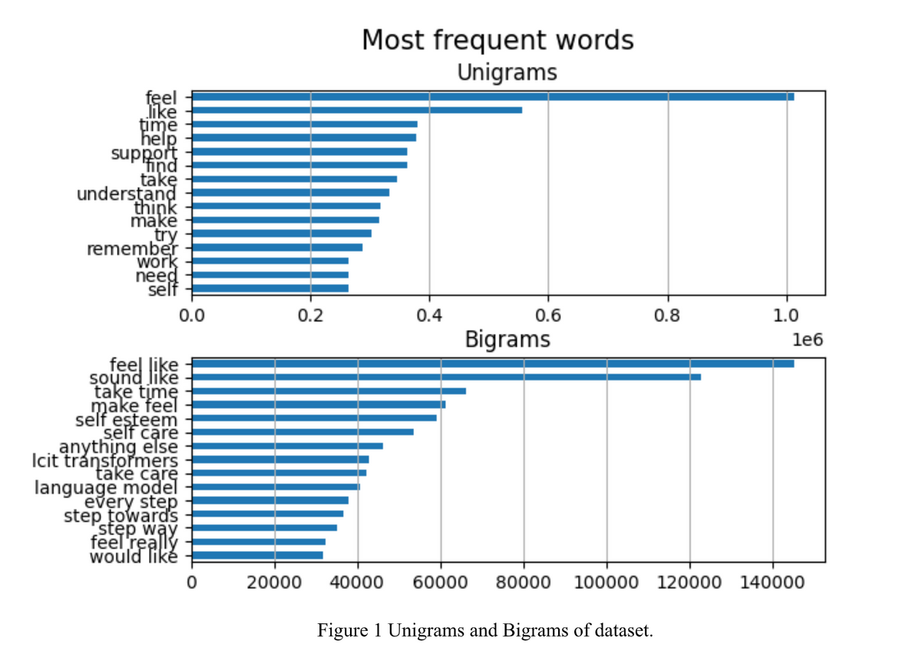
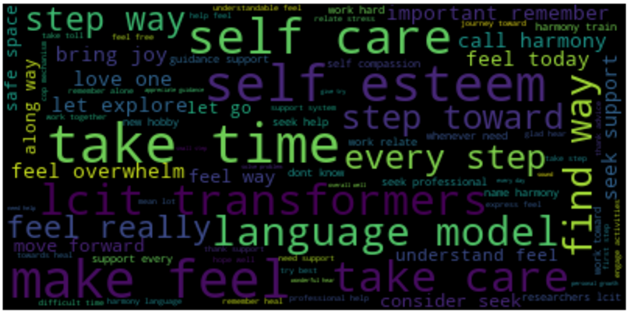
Data Exploration & Visualization
Unigrams and Bigrams
Word Cloud

Slide 10
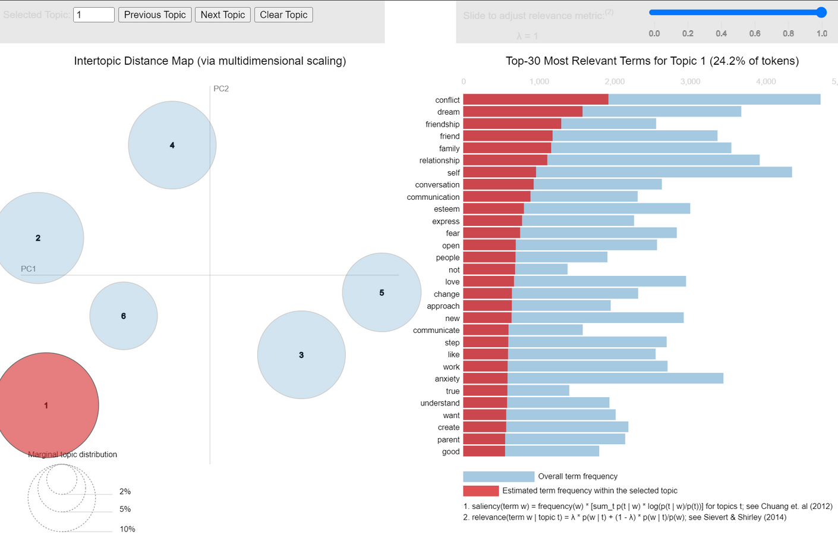
Data Exploration & Visualization
Latent Dirichlet Allocation (LDA)

Slide 11
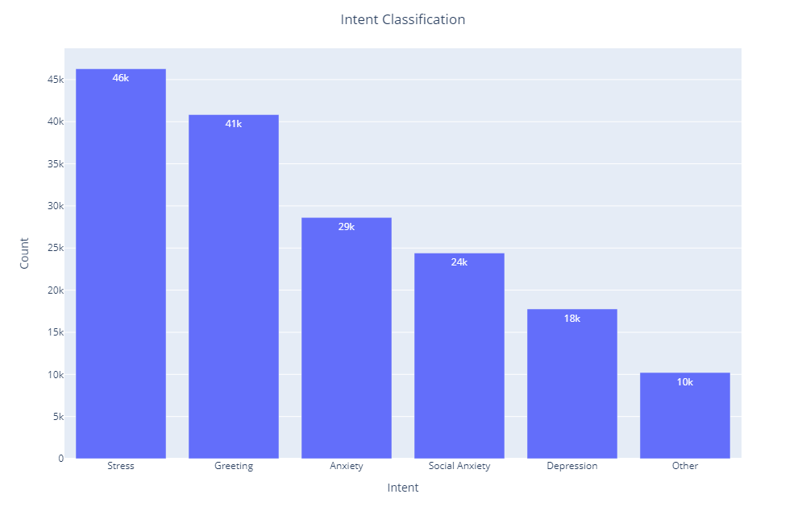
Data Exploration & Visualization
Intent Classification

Slide 12


Methods Used
Tokenization
Using pre-trained GPT2Tokenizer
Model training
Using GPT-2 Architecture
Training with 8 epochs
Varying block size

Slide 13
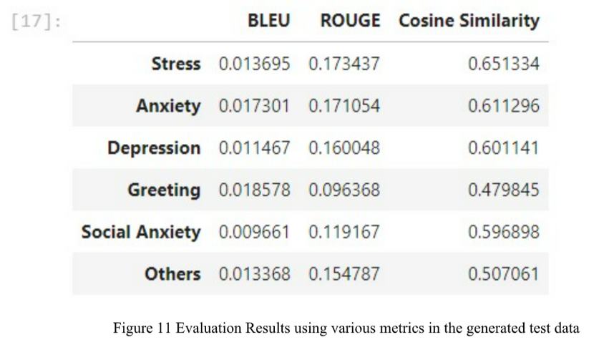
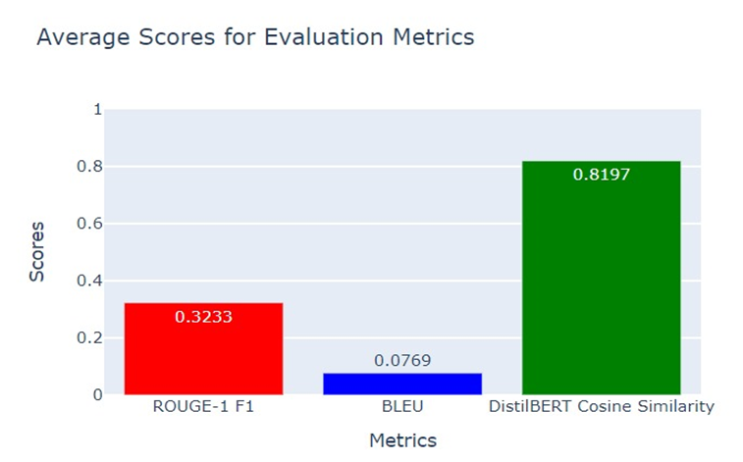
Model Evaluation
Generation of 100 records for every intent class
Evaluated model by comparing the responses with GPT4 generated responses
Assessments are based on the comparision with real world ChatGPT-4 generated actual bot response
Model Evaluation Metrics:
BLEU Score
ROUGE Score
DistilBERT Cosine Similar

Slide 14
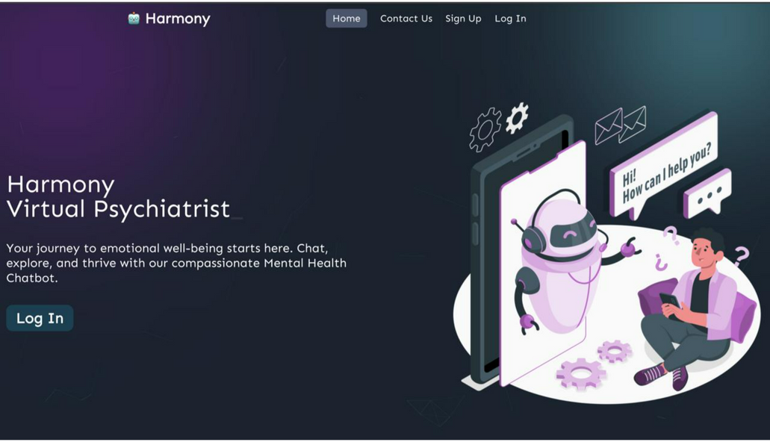
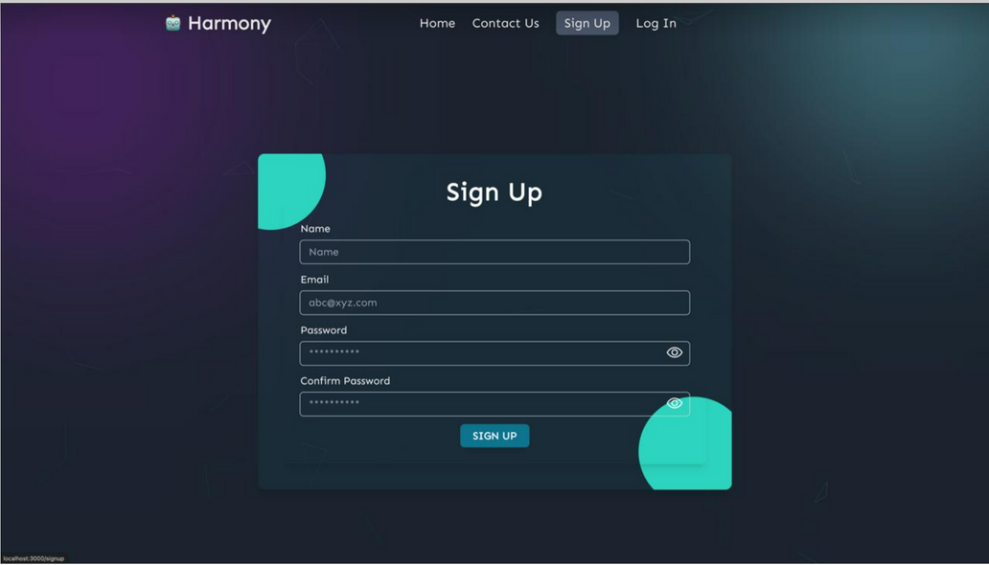
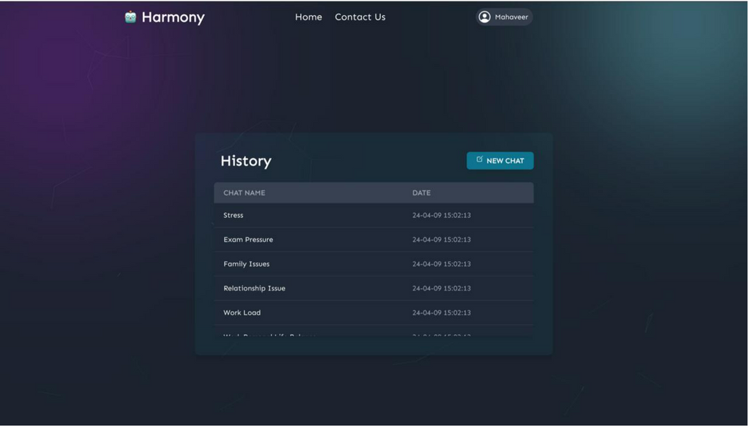
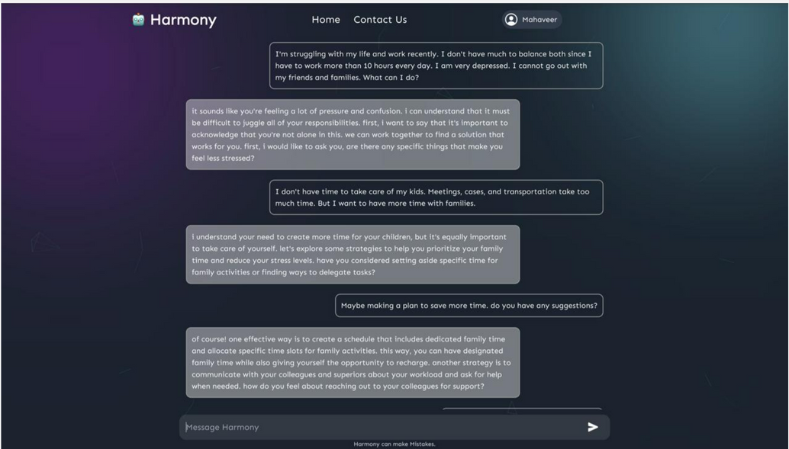
Results

Slide 15
Applications
24/7 Support
Stress Reduction
Lifestyle improvements
Anonymous Communication

Slide 16

Limitations
Medication concerns
Cross conversation challenge
Ending conversations with “Bye”
Limited length of conversations
What could be
the challenges?

Slide 17
Conclusion and Future Work
Creation and assessment of the Virtual Psychiatrist chatbot
Provide accessible and immediate support for individuals with mental health concerns.
Use contextually relevant datasets, the chatbot demonstrates linguistic coherence, relevance, and semantic understanding
Evaluation metrics such as BLEU, ROUGE, and DistilBERT Cosine Similarity used for testing and evaluation
Future improvements include continuous refinement of training data and algorithms
Overcome the current limitation of 1024 text size of the conversation, cross conversational challenge
Integrating multimodal input and output modalities, including voice recognition and facial expression analysis.

Slide 18
References
Santhosh, S. (2023, April 17). Understanding BLEU and ROUGE score for NLP evaluation. Medium. https://medium.com/@sthanikamsanthosh1994/understanding-bleu-and-rouge-score-for-nlp-evaluation-1ab334ecadcb
sentence-transformers/distilbert-base-nli-mean-tokens · Hugging Face. (n.d.). https://huggingface.co/sentence-transformers/distilbert-base-nli-mean-tokens
dslim/distilbert-NER · Hugging Face. (2001, January 18). https://huggingface.co/dslim/distilbert-NER
jerryjalapeno/nart-100k-synthetic · Datasets at Hugging Face. (2001, February 20). https://huggingface.co/datasets/jerryjalapeno/nart-100k-synthetic
alexandreteles/mental-health-conversational-data · Datasets at Hugging Face. (2023, September 27). https://huggingface.co/datasets/alexandreteles/mental-health-conversational-data

Slide 19
References
Amod/mental_health_counseling_conversations · Datasets at Hugging Face. (2001, March 4). https://huggingface.co/datasets/Amod/mental_health_counseling_conversations
Riyazmk/mentalhealth · Datasets at Hugging Face. (n.d.). https://huggingface.co/datasets/Riyazmk/mentalhealth
mpingale/mental-health-chat-dataset · Datasets at Hugging Face. (n.d.). https://huggingface.co/datasets/mpingale/mental-health-chat-dataset
jkhedri/psychology-dataset · Datasets at Hugging Face. (2023, October 6). https://huggingface.co/datasets/jkhedri/psychology-dataset
Papers with Code - PsyQA Dataset. (n.d.). https://paperswithcode.com/dataset/psyqa
EmoCareAI/Psych8k · Datasets at Hugging Face. (n.d.). https://huggingface.co/datasets/EmoCareAI/Psych8k

Slide 20


